Slide 1
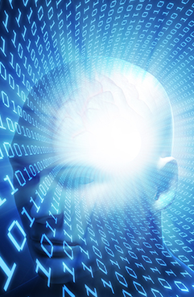
Data Science and AI Summer Camp Day 3
Topic 1: Random Numbers and Distributions
Topic 2: Linear Models and Beyond
Instructor: Ray Bai, Department of Statistics, UGA

Slide 2
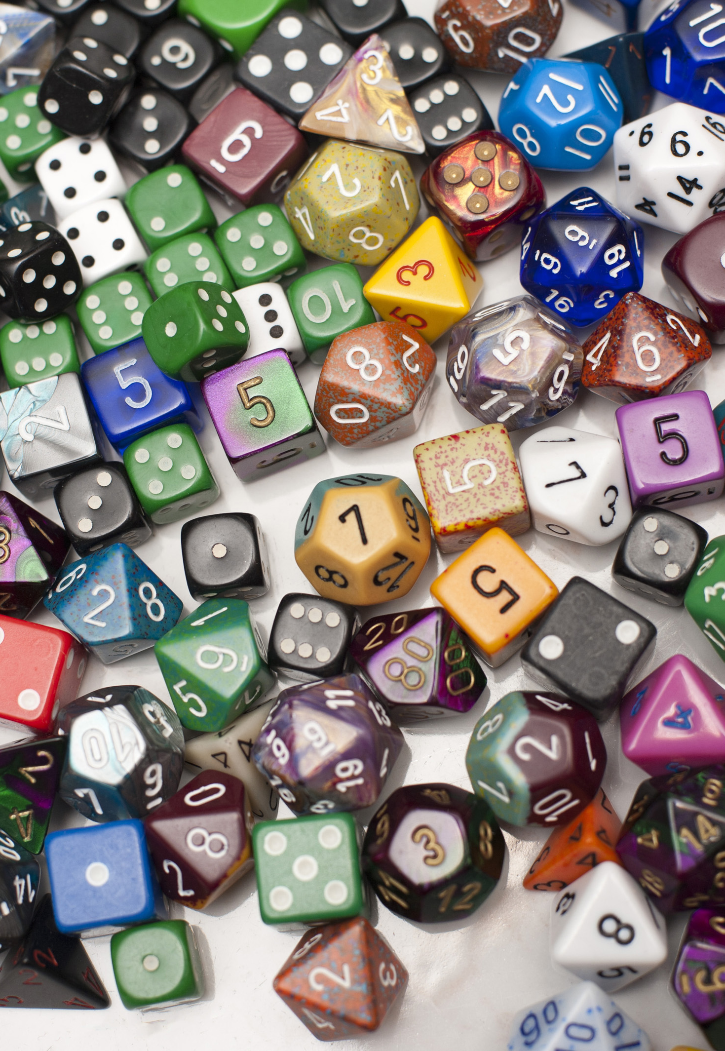
Topic 1: Random Numbers and Distributions
When analyzing data and implementing AI, we need to deal with randomness a lot.
Probability theory: mathematical language of randomness.

Slide 3
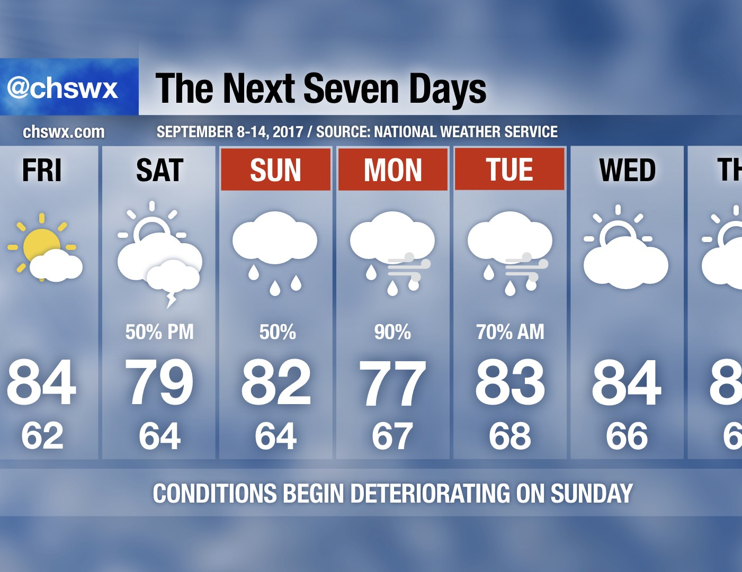

Slide 4

Use randomness to Train AI

Slide 5
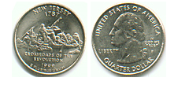
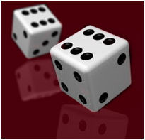

Experiment Randomness
Coin Flipper
https://www.random.org/coins/
Dice Roller
https://www.random.org/dice/
Bean Machine (Galton Board/Quincunx)
https://www.mathsisfun.com/data/quincunx.html
There are laws (patterns) behind randomness.
Law of Large Numbers: frequency stabilizes as sample size increases.
5

Slide 6

Random Numbers (Variables)
Random number: a number generated by chance (value varies from time to time).
When a random number is repeatedly generated, one often sees a pattern of likelihood of different values. Such a pattern is called a distribution.
With computers, random number generation are often implemented based on deterministic algorithm. Therefore, it is not strictly random: pseudo-random numbers. In practice, this is sufficient to fulfill most tasks.
https://demonstrations.wolfram.com/LinearCongruentialGenerators/
6
This Photo by Unknown Author is licensed under CC BY-NC

Slide 7
Use python to generate random numbers
Switch to Python…
7

Slide 8
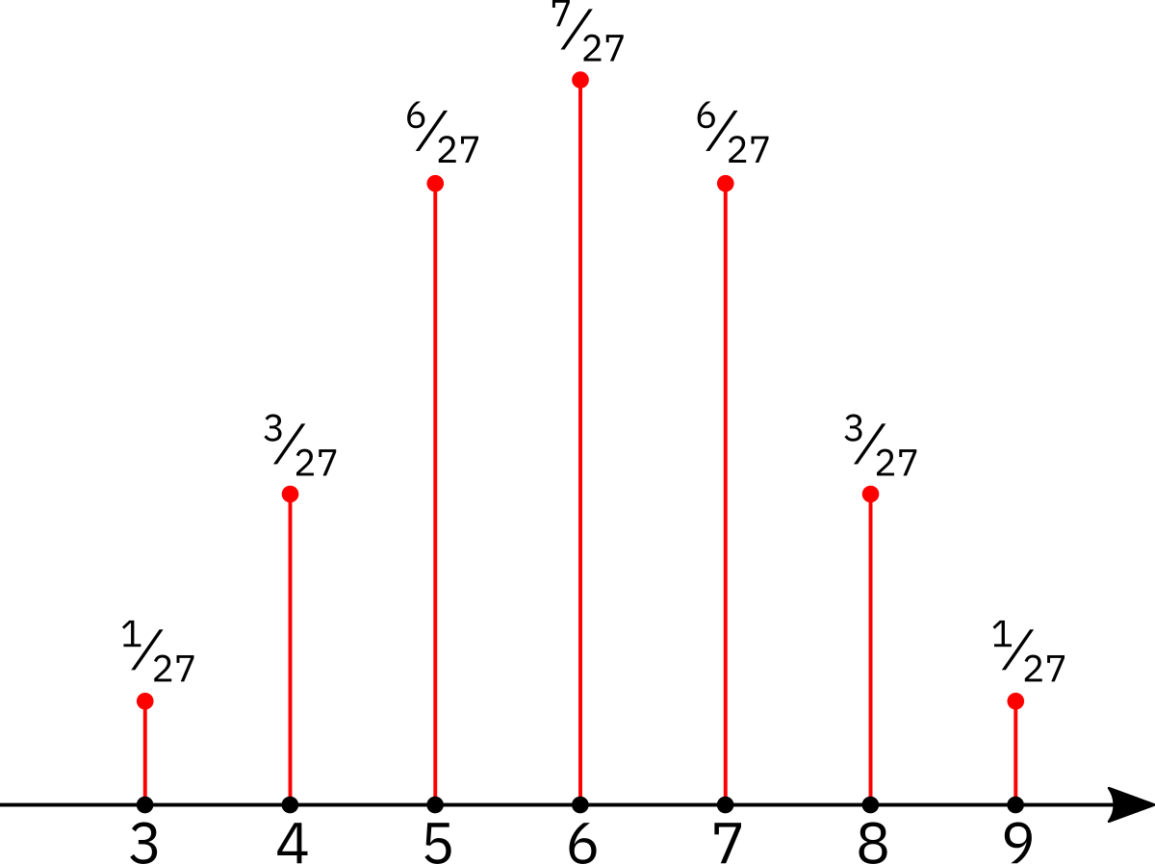
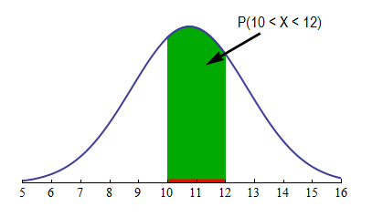
Distribution
Distribution: likelihood pattern of random number.
Discrete Distribution
Continuous Distribution
8
This Photo by Unknown Author is licensed under CC BY-SA

Slide 9
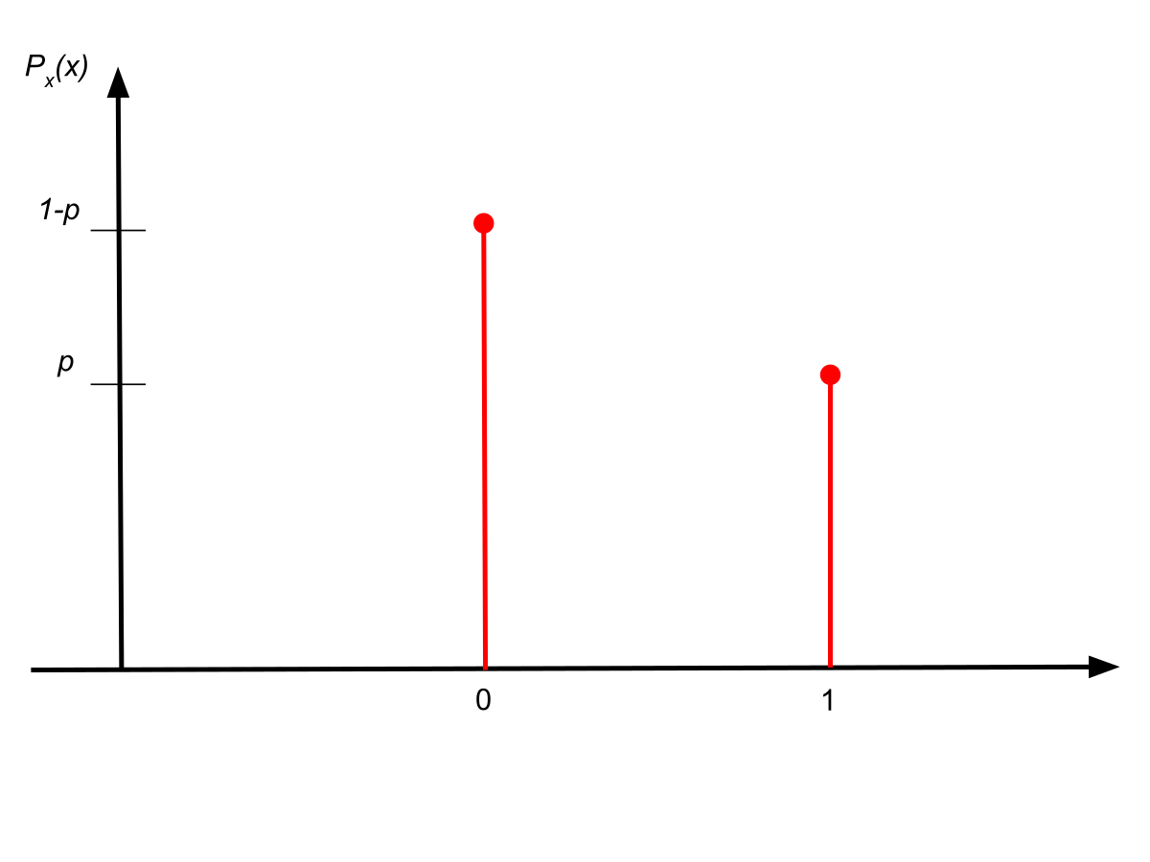
Some common distributions
Discrete Distribution
Bernoulli(p) distribution. Parameter p: within interval [0,1]
(Definition) Two possible values: 0 or 1. Probability of getting 1 is p; probability of getting 0 is 1-p.
In a coin toss, code `Heads’ as 1, and `Tails’ as 0
Bernoulli distribution with p = ?
9

Slide 10
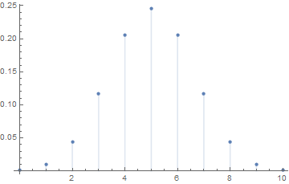
Some common distributions
Discrete Distribution
Binomial(n,p). Parameters: n integer 0,1,2,…; p: within interval [0,1].
(Definition)
Sum of n independent Bernoulli(p) random numbers= Number of 1’s
Another interpretation: a trial has two outcomes: success or failure. Perform the trial n times independently.
Binomial(n,p) describes the number of successes.
Binomial(n=10,p=0.5)
10

Slide 11
Work out Binomial(n=2,p=0.5)

Slide 12
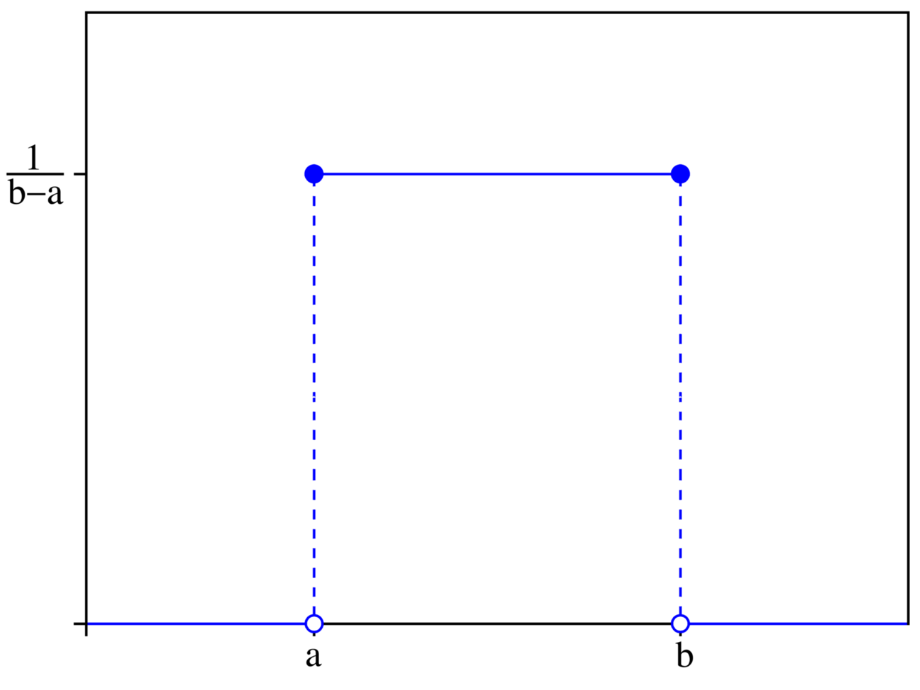
Some common distributions
Continuous Distribution
Uniform(a,b). Parameters a,b: real numbers, a<b.
(Definition) likelihood spread evenly over interval [a,b].
Q: Is it possible to have a uniform distribution on an interval of infinite length?
12
This Photo by Unknown Author is licensed under CC BY-SA

Slide 13
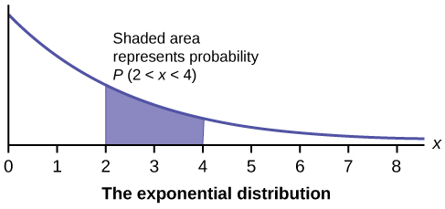
Some common distributions
Continuous Distribution
Exponential
Omit precise definition. On the positive real line.
Often used to describe time elapsed between events.
Memoryless: no matter how long you have waited so far, you need to wait additionally as if you just started waiting.
13

Slide 14
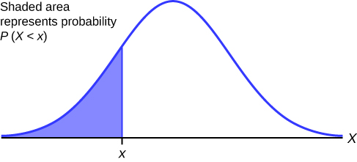
Some common distributions
Continuous Distribution
Normal distribution
Omit precise definition. On the whole real line.
Note: probability density curve forms a bell shape.
Often used to describe the distribution of sample mean, and more.
Central Limit Theorem: normal distribution arises from an aggregation of a large number of small random disturbances.
Application of Central Limit Theorem in Real Life
14

Slide 15
Use python to generate random numbers following certain distributions
Switch to Python…
15

Slide 16
Transformation
In practice, we can generate random numbers of a different distribution by doing transformation of the random numbers of an existing distribution.
For example, We can generate exponential distribution from uniform distribution.
The explanation of why transformation works requires deeper knowledge of probability theory.
16

Slide 17
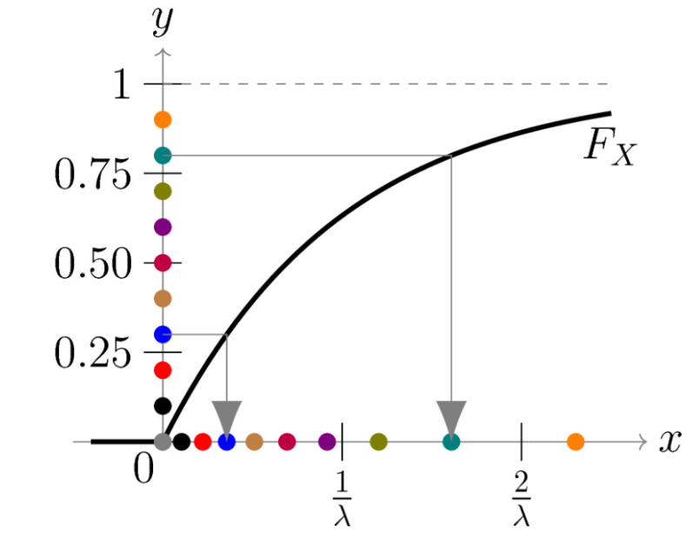
Transformation
Transform uniform distribution to a non-uniform distribution
17

Slide 18
Practice
Switch to python…
18

